Slide 1

Ramrao Adik Institute of Technology
Department of Computer Engineering
TE Project Mock 1 Presentation
On
“Dynamic Recipe Recommender:Enhancing Cooking Choices with Machine Learning”
By
22CE1285 Deeptanshu Lal
22CE1150 Nauman Pathan
22CE1008 Sara Pathan
22CE1054 Soham Pardhi
Guided by
Dr.Smita Bharne

Slide 2
Outline
Introduction
Literature Survey of the existing systems
Limitations of the existing systems
Problem statement
System Design
Technologies and methodologies
Conclusion and Future Scope
References

Slide 3
Introduction
A recipe recommendation system is a type of content-based filtering system that suggests recipes to users based on their personal preferences.
Motivation:With the rise of online recipe platforms and social media, the amount of recipe data available has grown exponentially, making it increasingly difficult for users to discover new recipes that cater to their personal preferences, dietary needs, and cooking skills. Moreover, traditional recipe search engines often rely on simple keyword matching, failing to capture the nuances of human language and the complexity of culinary preferences.
Objectives:We aim to bridge this gap and provide users with a personalized and intuitive cooking experience. Our system will enable users to input their preferences and requirements in natural language, and receive tailored recipe suggestions that take into account their unique needs and tastes.

Slide 4
Literature Survey of the existing systems
This literature survey provides an overview of existing recipe recommendation systems:
Content-Based Filtering:One of the earliest approaches which involves content-based filtering, which involves analyzing the features of recipes and user preferences . For example, [1] proposed a content-based filtering system that used a weighted sum of recipe features, such as ingredients, cooking time, and nutritional information.
Collaborative Filtering:Collaborative filtering is another popular approach which involves analyzing the behavior and preferences of similar users to make recommendations. For example, [2] proposed a collaborative filtering system that used matrix factorization based on their past behavior and preferences.
Natural Language Processing:Natural language processing (NLP) techniques have also been used to analyze user preferences and recipe features. For example, [3] proposed an NLP-based system that used sentiment analysis to analyze user reviews and ratings.

Slide 5
Limitations of existing systems
Limitations of the existing recipe recommendation systems are:
Cold Start Problem:One of the major limitations of existing Recipe Recommendation Systems is the cold start problem, where there is limited user data or recipe data available.
Lack of Personalization:Many existing Recipe Recommendation Systems lack personalization, where the system fails to consider individual user preferences, dietary restrictions, and cooking skills.
Limited Context Awareness:Existing systems often lack context awareness, where the system fails to consider the user's current situation, such as their location, time of day, and available ingredients.
Dependence on User Feedback:Many Recipe Recommendation Systems rely heavily on user feedback, such as ratings and reviews, which can be subjective and biased.

Slide 6
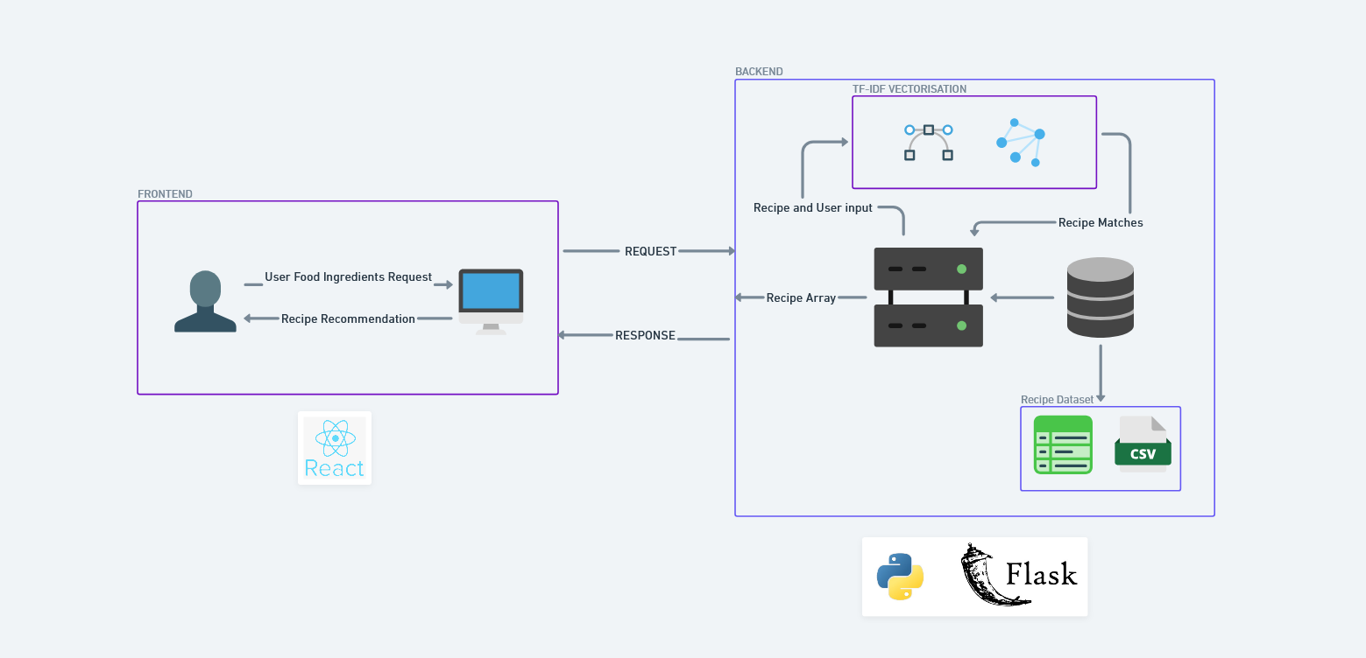
Problem statement

Slide 7
Problem statement
PROJECT WORKFLOW
Given a dataset of recipes with their corresponding ingredients, develop a recommendation system that suggests a list of recipes to a user based on the ingredients they have or prefer. The system should be able to handle a large dataset of recipes.This system has an intuitive veg/non-veg toggle ensures that users can effortlessly switch between plant-based and meat-inclusive recipe options, catering to diverse dietary preferences and lifestyles.

Slide 8
System Design
The system design for the recipe recommendation algorithm consists of six modules:
Data Ingestion module reads in the recipe data from a CSV file using the Pandas read_csv function. This module is responsible for ingesting the recipe data into the system. The CSV file contains a row for each recipe, with a column for ingredients.
Data Preprocessing module preprocesses reduces the dimensionality of the ingredient data and prepares it for feature extraction.
Feature Extraction module converts the preprocessed recipe ingredients into numerical vectors . This module uses the Scikit-learn TfidfVectorizer algorithm to create a vector representation of each recipe's ingredients.
Similarity Calculation module calculates the cosine similarity between the recipe vectors and the user's ingredient vector. This module uses the Scikit-learn cosine_similarity function to measure the similarity between the two vectors.

Slide 9
Technologies and methodologies
Here are the technologies and methodologies that will be used in this recipe recommendation System:
Technologies :The primary programming language used for developing the algorithm is Python. The libraries and frameworks used include Pandas for data manipulation and CSV file reading, Scikit-learn for text preprocessing, TF-IDF vectorization, and cosine similarity calculation, and NumPy for numerical computations and vector operations.
Methodologies : The development methodology used will be agile development, with iterative development and testing cycles. The algorithm will be tested using unit tests to ensure that each module is functioning correctly, and integration tests to ensure that the modules are working together correctly. The algorithm will be deployed on a cloud platform such as AWS .

Slide 10
Conclusion and Future Scope
The development of this recipe recommendation algorithm is a significant achievement that has the potential to transform the way people cook and interact with food. By leveraging machine learning, natural language processing, and data-driven approaches. The successful implementation of this project demonstrates the power of technology in improving people's lives, making cooking more accessible, and promoting culinary exploration and creativity.
As we continue to push the boundaries of culinary innovation, the future of this recipe recommendation system holds:
A mobile app can be developed to provide users with a convenient and accessible way to input their ingredients and receive recipe recommendations on-the-go.
This system can be explored for other applications such as recommending food products, suggesting meal plans for specific health conditions, or even generating recipes for specific occasions. events.

Slide 11
References
The following references were consulted and utilized in the development of the recipe recommendation system, that enabled the creation of a robust and effective system:
"Food Recommendation System using Natural Language Processing" by A. K. Mishra et al.
Author: A. K. Mishra, S. K. Singh, and A. K. Singh
Publisher: Elsevier
Page Number: 101-112
Year of Publication: 2020
Link: https://www.sciencedirect.com/science/article/pii/S2212670820300325
"Natural Language Processing with Machine Learning" by Rajesh Arora
Author: Rajesh Arora
Publisher: Springer
Year of Publication: 2020
Link: https://link.springer.com/book/10.1007/978-3-030-44435-6

Slide 12
Thank You

